Slide 1

Mobile Application Development, Fall 2021 Introduction to State Management Part 1

Slide 2
Today’s Agenda
Intro to State
A Quick Lifecycle Diagram And Other Notes
Color App

Slide 3
Intro to State!
ImageScreen
All semester long, we’ve seen been working with props!
Last class we passed our own custom props down into our own custom components!
{title: “coffee”,
image: cof.jpg”}
{title: “doughnut”,
image: d.jpg”}
{title: “sandwich”,
image: s.jpg”}
ImageDetail
ImageDetail
ImageDetail

Slide 4
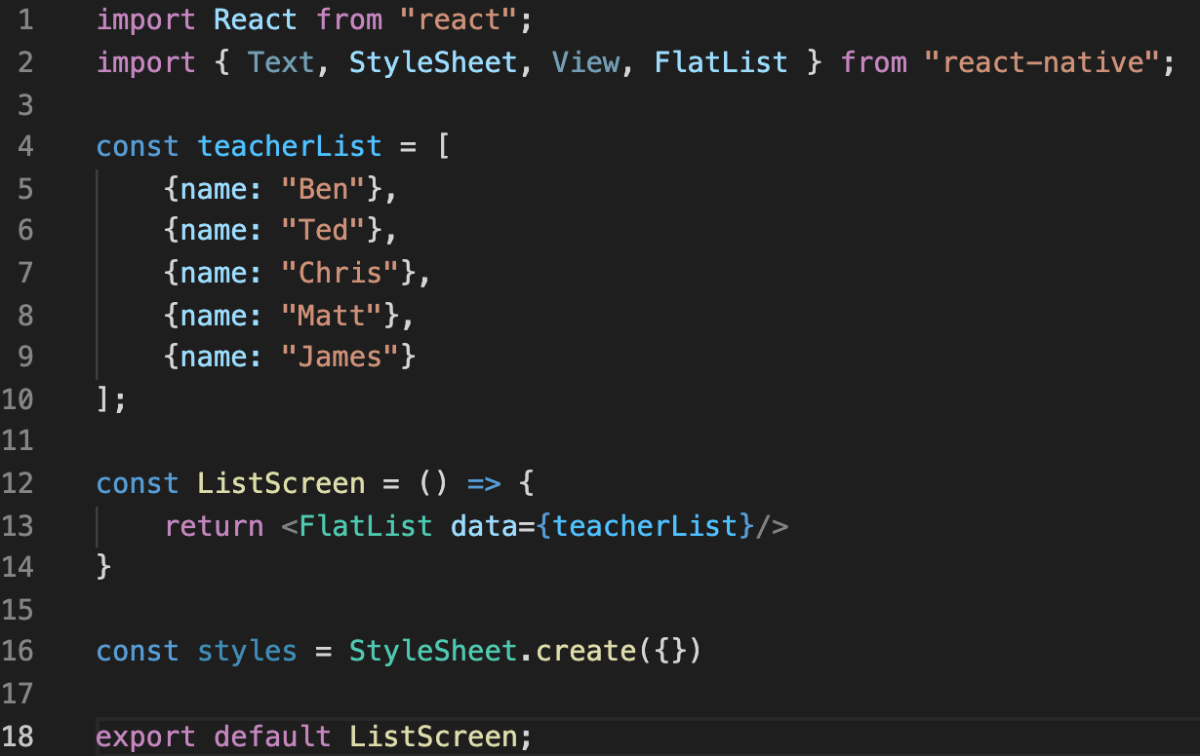
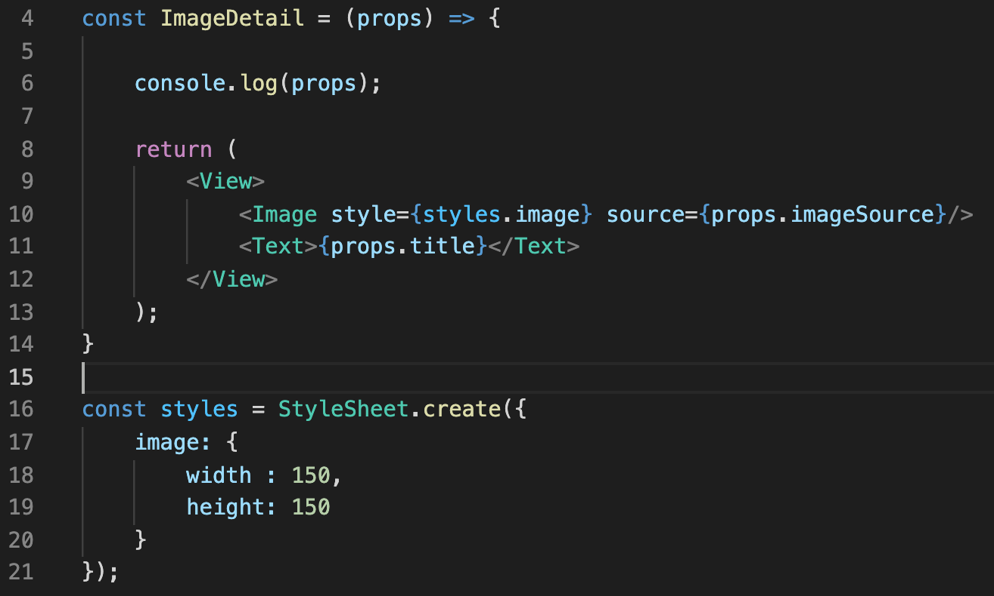
Intro to State!
But indeed, we’ve been using them in lots of situations!
Such as the “data” prop for FlatList
The ‘source’ prop for Image
The ‘style’ prop for basically everything!
We hopefully feel pretty good about props!
A way for a parent component to send data to a child component

Slide 5
Intro to State!
Props aren’t going away anytime soon!
But today, we’ll introduce another system that is similar in some ways to props, but are used for a very different purpose!
Today, we discuss the state system.

Slide 6
Intro to State!
If props are a way to get the system to pass data from parent to child…
State is a way to track a piece of data that will change over time.
If that data ever changes, our app will ‘rerender’
(i.e., re-draw itself to the screen).

Slide 7
Intro to State!
Both of these systems deal with data!
And as we start working with both of them, it’s easy to get them confused with one another!
That’s ok, we’ll figure it out!
So we’ll say it again…

Slide 8
Intro to State!
Both of these systems deal with data!
And as we start working with both of them, it’s easy to get them confused with one another!
That’s ok, we’ll figure it out!
So we’ll say it again…

Slide 9

Intro to State!
ImageScreen
Props are for passing data down from parent components to child components.
And state is for tracking data that changes over time, so our app can rerender with updated values.
Let’s see some quick examples of this!
{title: “coffee”,
image: cof.jpg”}
{title: “doughnut”,
image: d.jpg”}
{title: “sandwich”,
image: s.jpg”}
ImageDetail
ImageDetail
ImageDetail

Slide 10
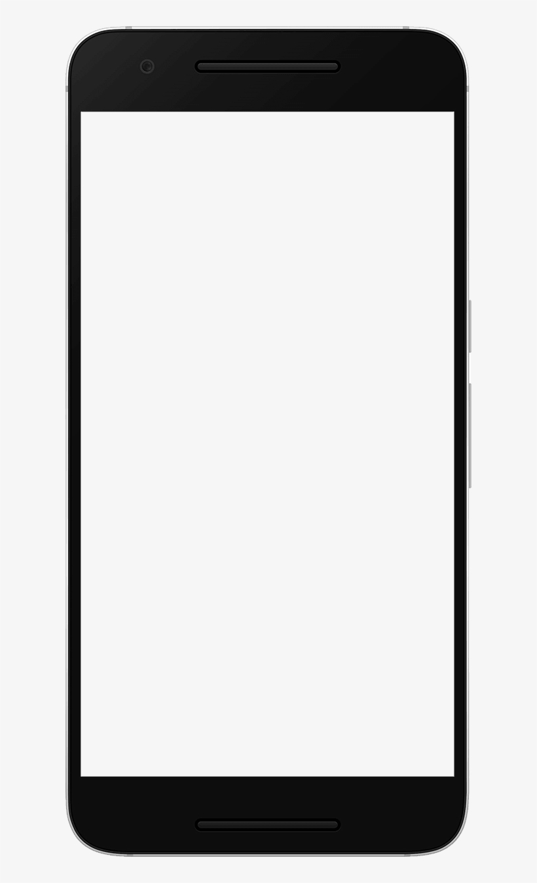
Intro to State!
Increase
A common app for illustrating state is a counter app!
So imagine that you have something that looks like this, with a couple of of buttons and some text!
Decrease
Current Count:
0

Slide 11


Intro to State!
Increase
Decrease
Increase
Current Count:
As you might imagine, clicking “Increase” makes the count go up…
and clicking “decrease” makes the count go down.
Decrease
1
Current Count:
0
Increase
Decrease
Current Count:
-1

Slide 12
Intro to State!
Increase
This will make more sense in a moment but for now, just trust me!
When working with state, there are three questions you should ask yourself:
1.) What piece of data is changing?
2.) What is the type of the changing data?
3.) What is the data’s starting value?
Decrease
Current Count:
0

Slide 13
Intro to State!
Increase
Let’s do that together for this one?
1.) What piece of data is changing?
The count!
2.) What is the type of the changing data?
It’s a number! So an ‘int’ probably!
3.) What is the data’s starting value?
0
Decrease
Current Count:
0

Slide 14



Intro to State!
Enter Your Name:
Let’s do it again with a new app!
This is another small little guy!
It has a couple of text elements.
It also has a field where the user can type in their name…
Your name is:

Slide 15


Intro to State!
Enter Your Name:
Benjami
So if I were to type in my name in the box up there…
As I type each character, they start showing up one at a time down here, too.
Your name is: Benjami

Slide 16
Intro to State!
Enter Your Name:
Benjami
So great! Let’s ask ourselves our same three questions again!
1.) What piece of data is changing?
The name!
2.) What is the type of the changing data?
It’s probably going to be a String!
3.) What is the data’s starting value?
The empty string! “”
Your name is: Benjami

Slide 17
Intro to State!
Posts
Favorite TV character?
OK, one more time. Imagine that we have Reddit or some blog post app on our phone.
And as new posts come in, we want them to re-render on the screen here, getting added to the list.
Good Doggo!
Funniest Line in a movie?
You have to ask yourself…

Slide 18
Intro to State!
Posts
Favorite TV character?
Now, we aren’t going to get too deep into the engineering behind this hypothetical app…
But probably we don’t have just some built-in hard-coded list of blog posts in the app, right?
There’s probably an API where we can go and fetch new posts as they are added, for us to display.
Good Doggo!
Funniest Line in a movie?
You have to ask yourself…

Slide 19
Intro to State!
Posts
Favorite TV character?
One last time….
1.) What piece of data is changing?
The variable that is storing the retrieved blog posts!
2.) What is the type of the changing data?
An array of objects.
3.) What is the data’s starting value?
It will likely begin as empty. (e.g., [] )
Good Doggo!
Funniest Line in a movie?
You have to ask yourself…

Slide 20
Intro to State!
Increase
OK! Great! As we begin to dig into working with state, we’ll be asking ourselves these questions regularly!
Let’s make a quick and dirty example!
Namely, this counter example!
We know how to make buttons and text elements!
But how to make a button change state?
Decrease
Current Count:
0

Slide 21
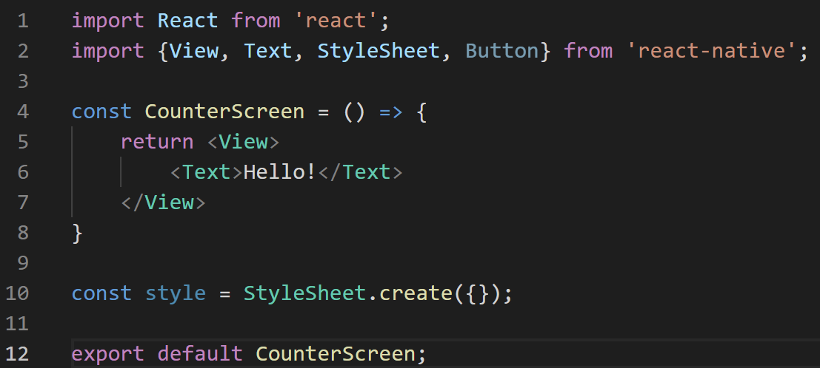
Intro to State!
We once again, create another new screen for this guy, using the boilerplate we’ve seen so many times!
This will be a new screen, called CounterScreen.js
Hopefully this feels like second nature to you by now!
CounterScreen.js

Slide 22
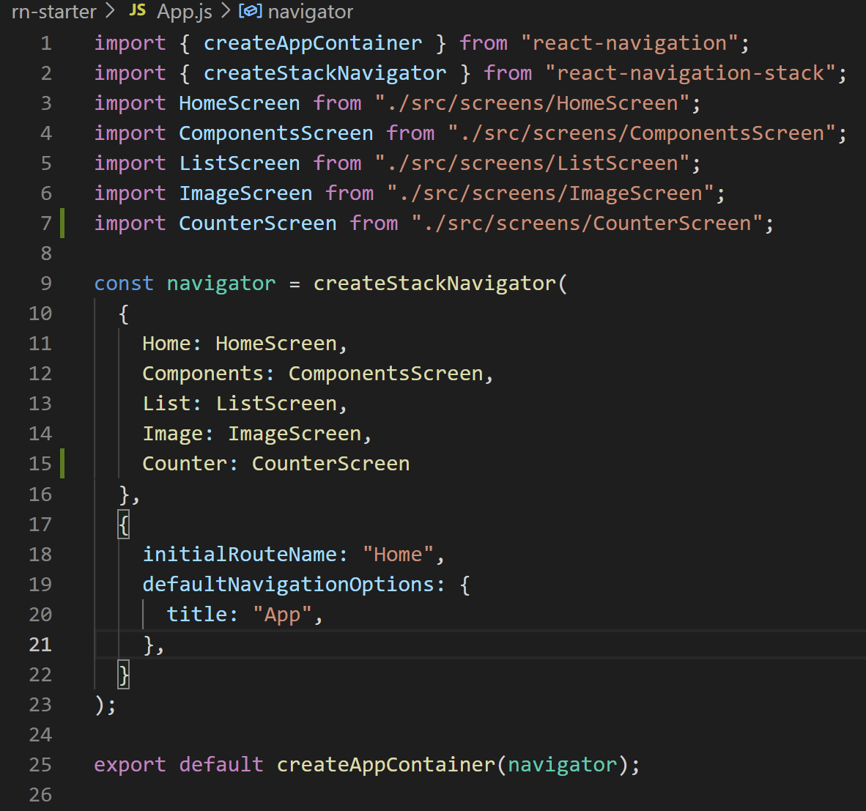

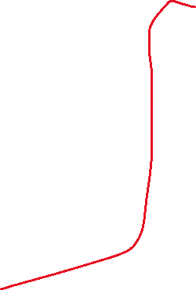
Intro to State!
And don’t forget to hook it up to App.js!
There’s a lot of stuff going on here in mine, but there’s really only two lines that we changed
importing what we just exported
Adding it as a routing option
App.js

Slide 23
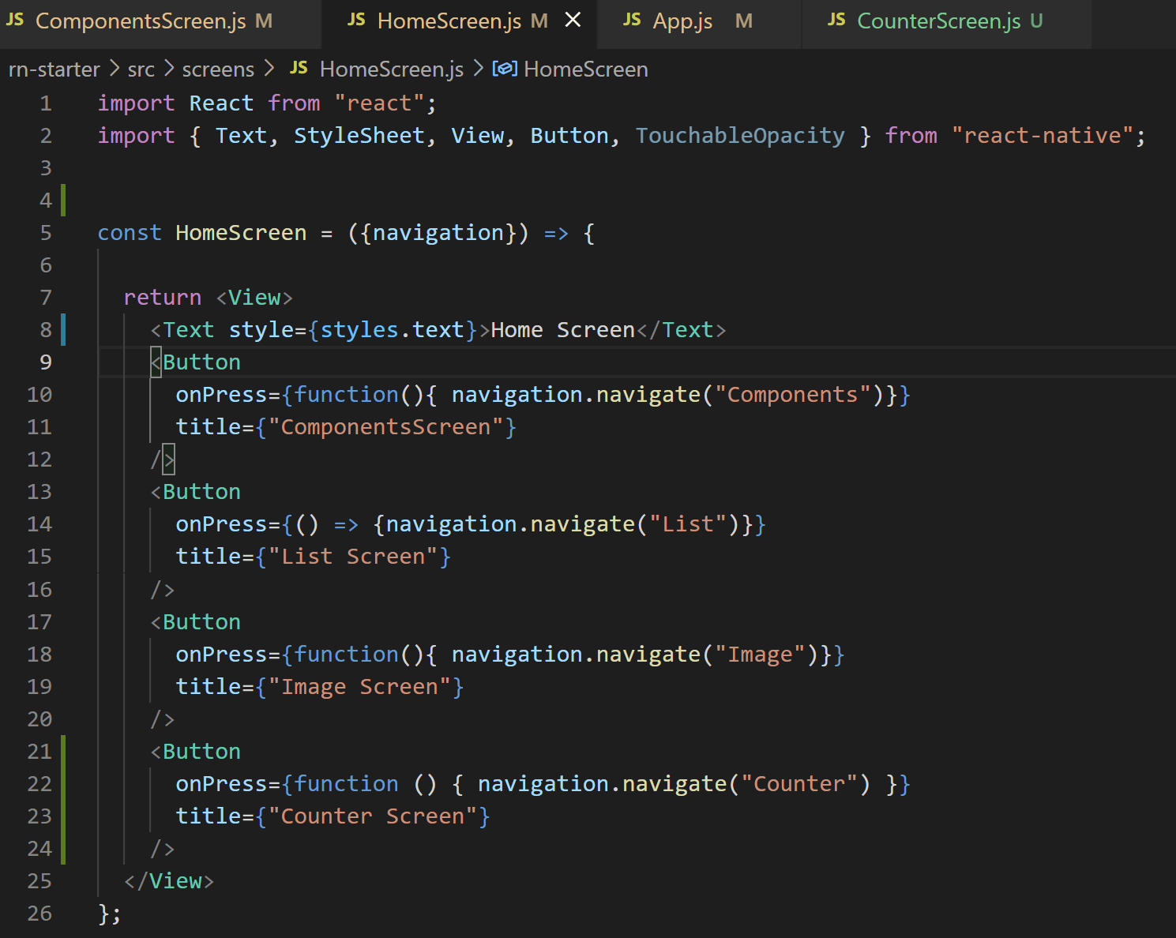
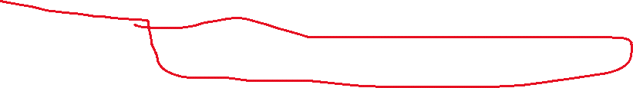
Intro to State!
And if you’re following along at home and want to add this to our homescreen…
We need to make sure we add the appropriate button for that!
HomeScreen.js

Slide 24
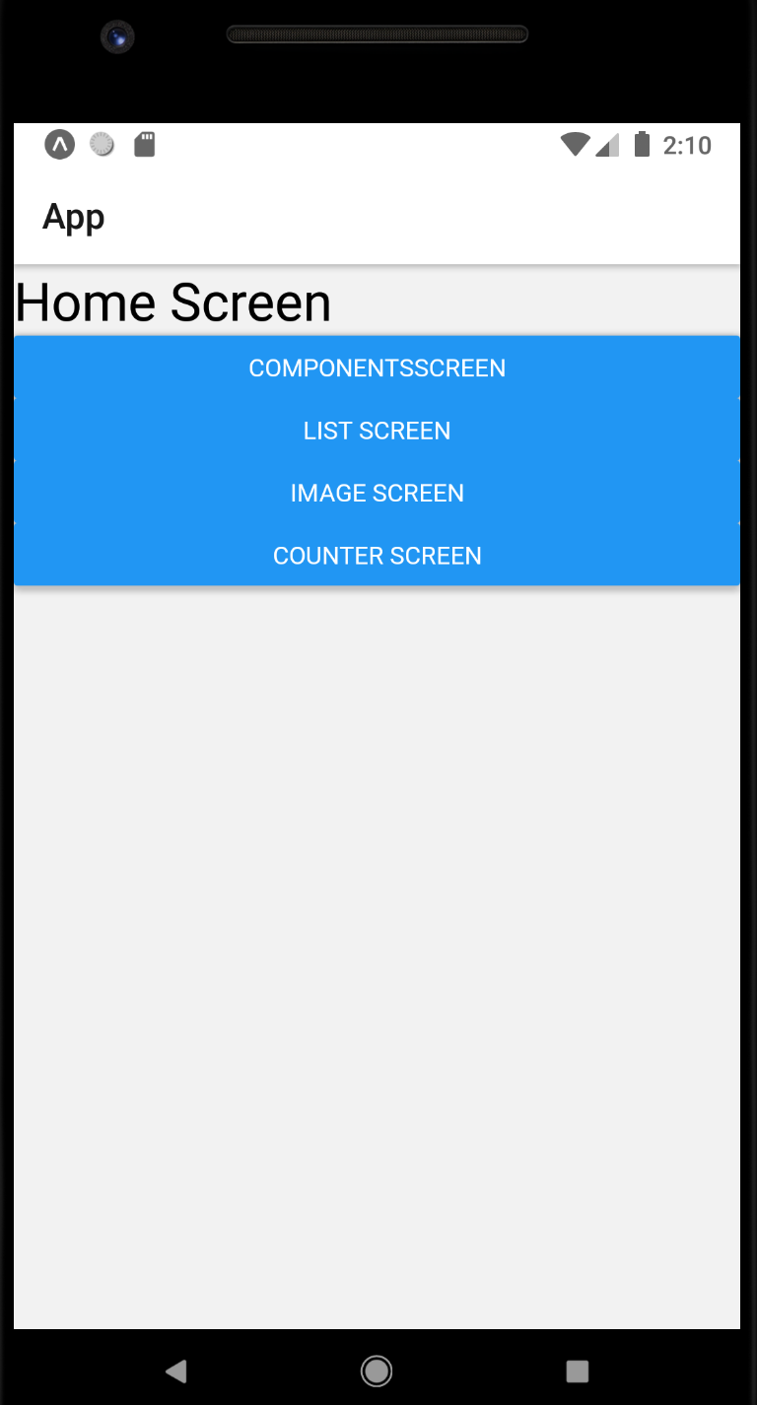

Intro to State!
And with all of those things in place, we should have a new button we can push!
That will take us to a (currently more-or-less- blank screen)

Slide 25
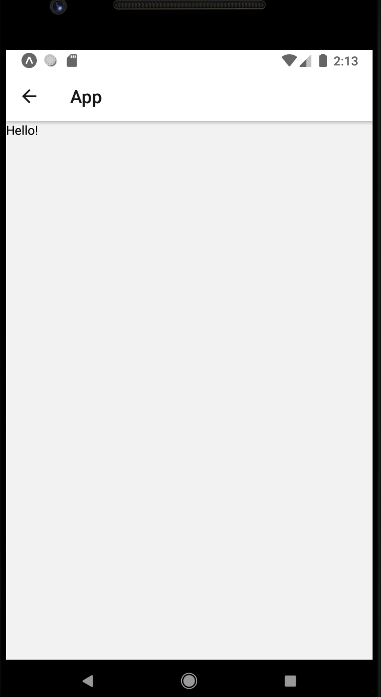
Intro to State!
Increase
The app on the left is what we currently have.
The mockup on the right is what we’re aiming for!
Clearly there are some changes to make!
Decrease
Current Count:
0

Slide 26
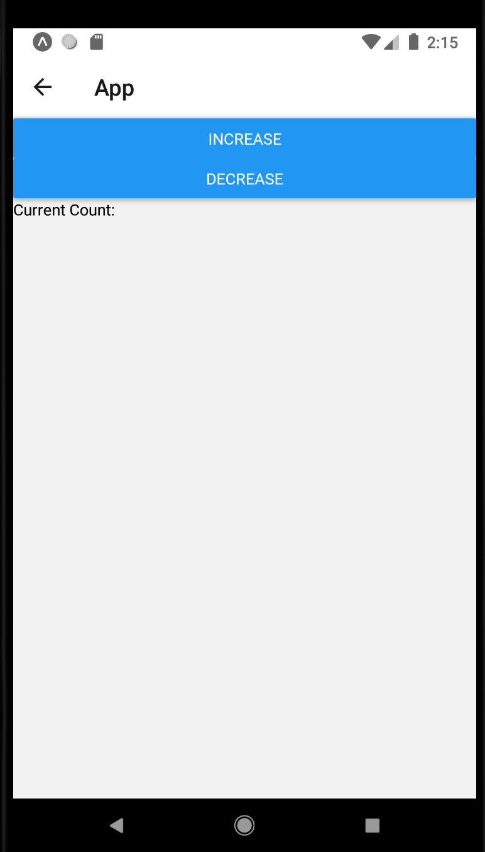
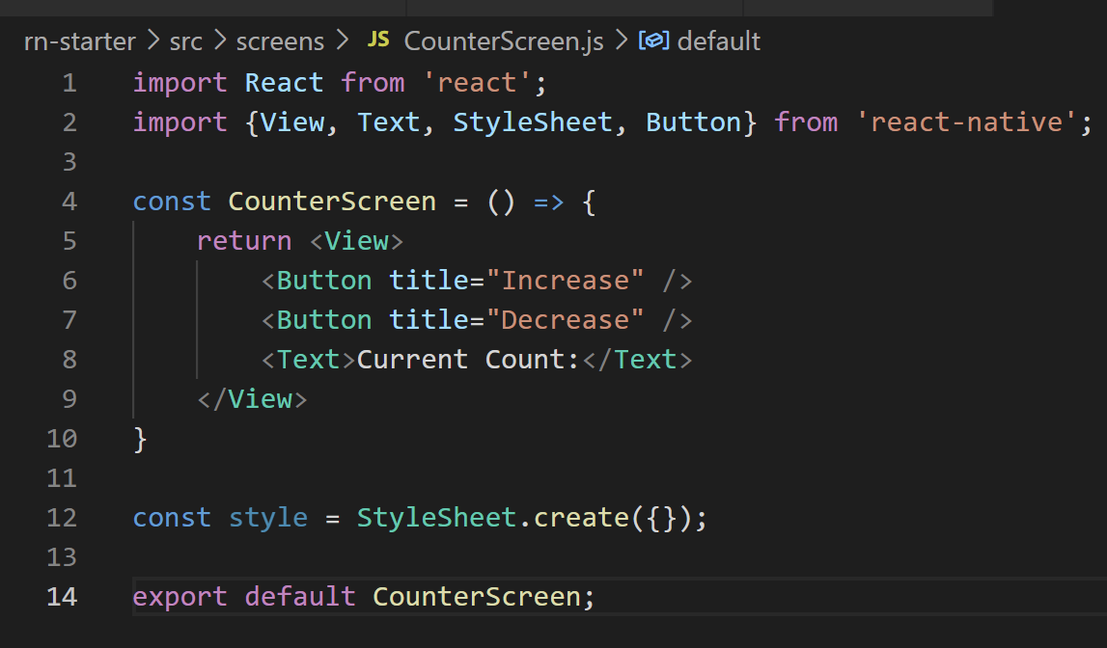

Intro to State!
We can add some a couple Button elements…
Change the text…
And we’re already a lot closer!
CounterScreen.js

Slide 27
Intro to State!
Increase
But even though we’ve worked with variables all the time in other classes…
We still haven’t actually seen how to use a variable in this way in React Native!
Any thoughts on how we might go about doing this?
Decrease
Current Count:
0

Slide 28
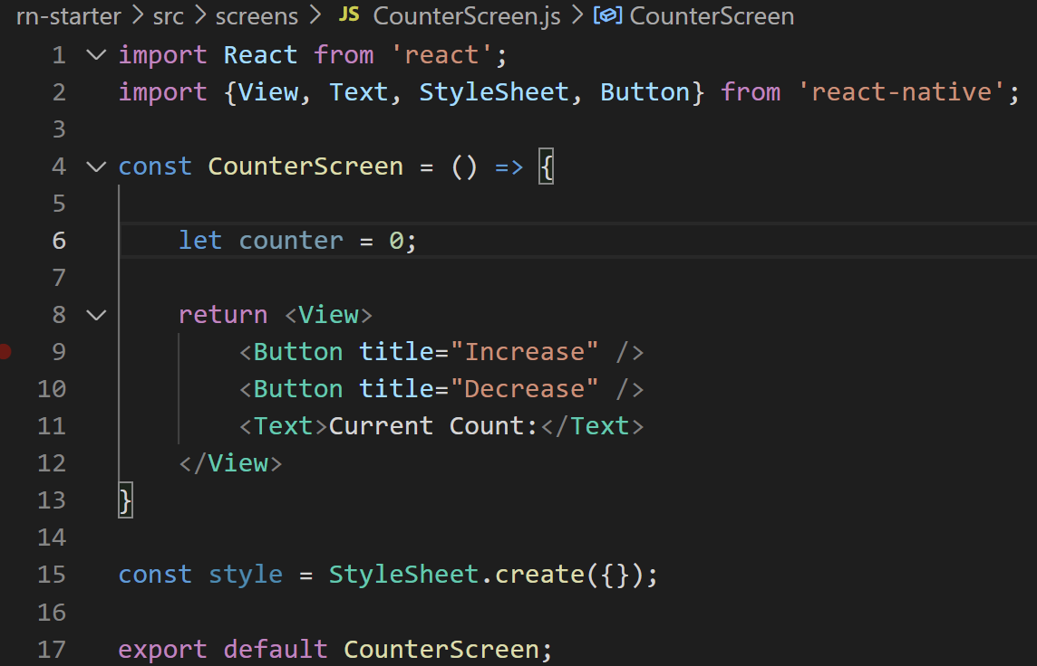

Intro to State!
If you are like me, you’ll probably think to yourself…
“Gee! I need a variable to store the number!”
(let in javascript is a way to declare a variable that has scope local to the block it’s declared in).
CounterScreen.js

Slide 29
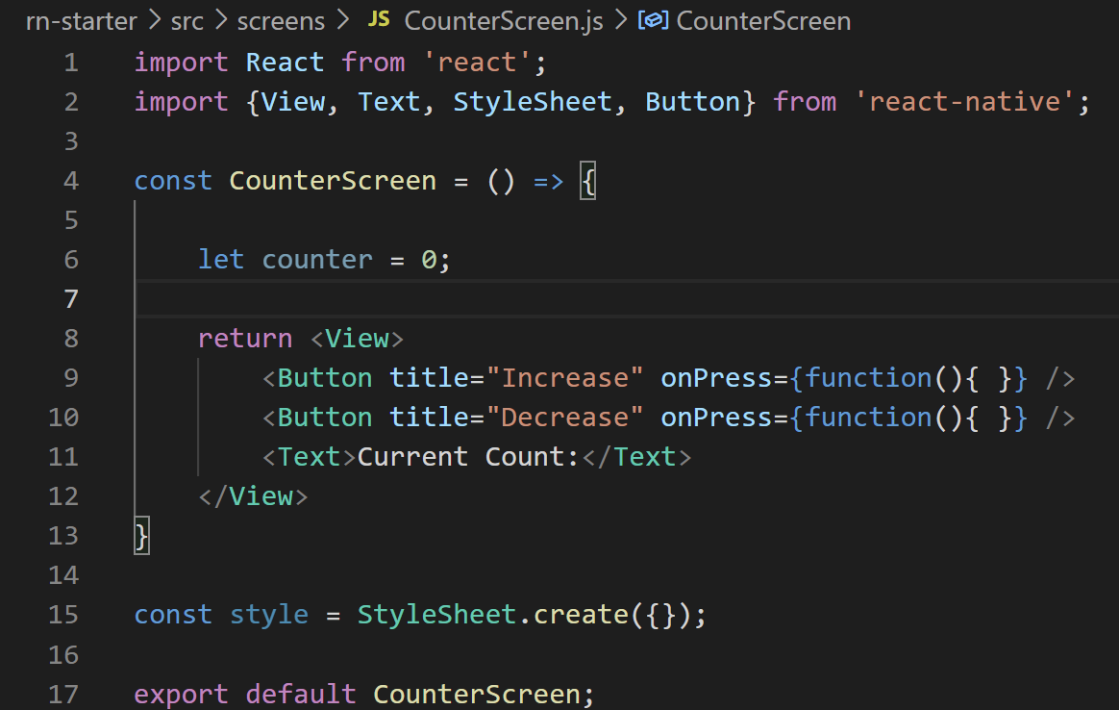
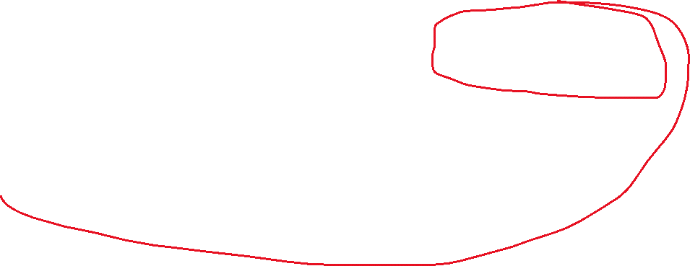
Intro to State!
And you also might think…
“Well, I remember that Button elements have the onPress prop!”
The “handler” for when an “event” happens!
So you might be tempted to start with these empty functions…
CounterScreen.js

Slide 30
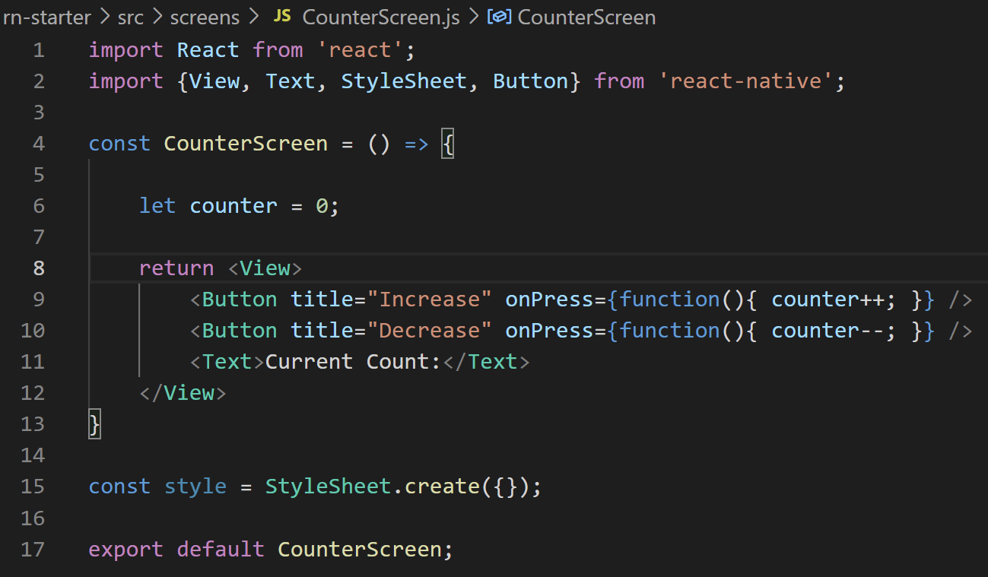

Intro to State!
And then maybe have those functions increase or decrease the counter variable!
CounterScreen.js

Slide 31
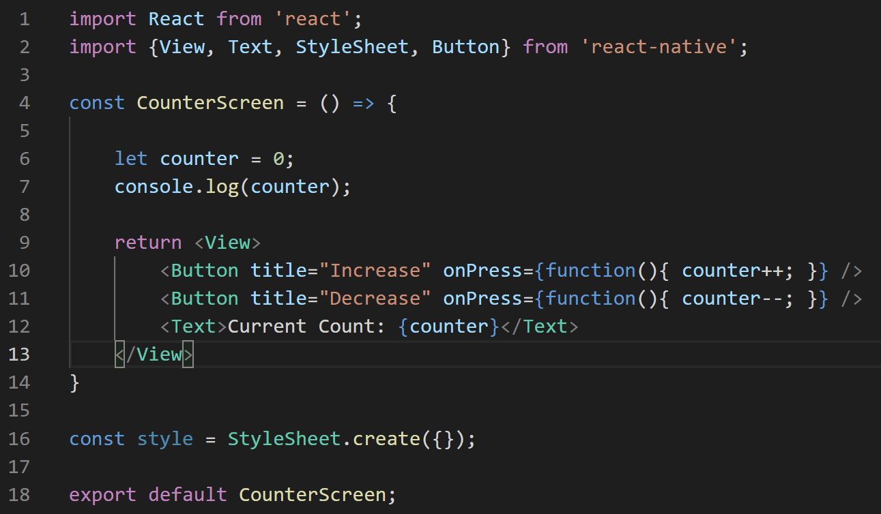
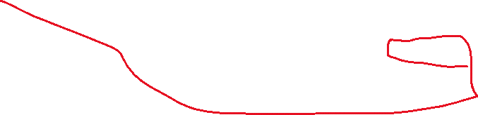
Intro to State!
And then, finally, actually printing the value of that variable out.
CounterScreen.js

Slide 32
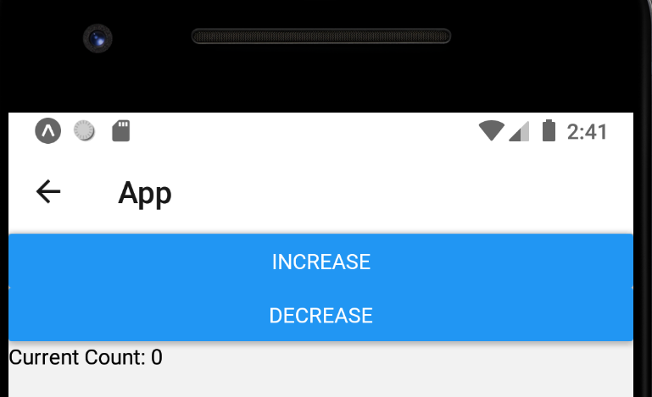
Intro to State!
I warned you at the top of this: this isn’t quite right.
BUT – it probably seems reasonable, yeah?
Sadly, no matter how many times you push the buttons, it will always just say 0.
Why is that?
CounterScreen.js

Slide 33
Intro to State!
It has more to do with how screens render, than it does with problems with our logic.
Most of what we have here *is* actually just fine!
And more than that: we *are* changing the variable!
CounterScreen.js

Slide 34
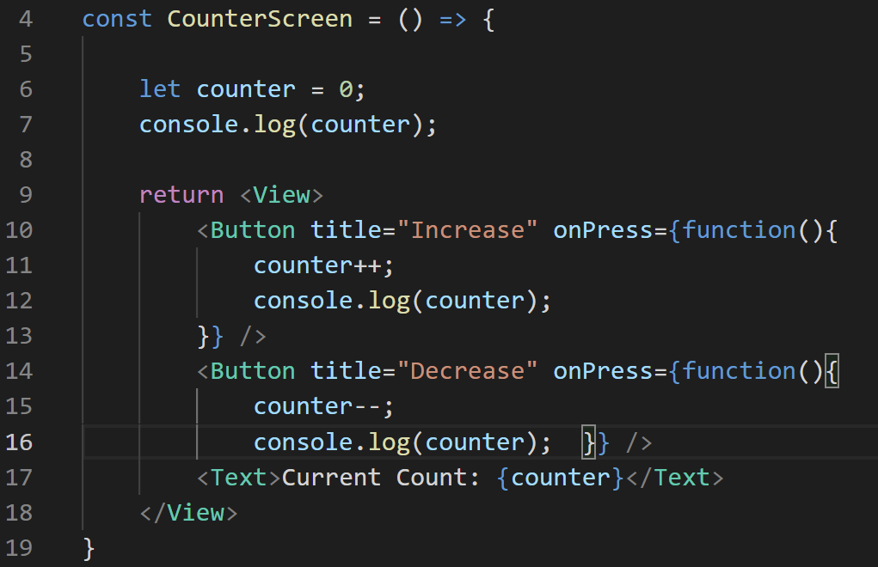
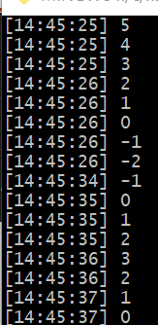
Intro to State!
I’ve added some console.log lines inside of the Button handlers.
They print out the value of counter.
And if we take a look at the console output (after I push the buttons a few times)…
We can see that counter, is in fact, going up and down!
CounterScreen.js

Slide 35
Intro to State!
So our logic to change the variable seems good!
But the screen isn’t updating?
What gives!?!
Again, it boils down to when the screen is getting rendered.
CounterScreen.js

Slide 36

Intro to State!
When you first “go to” this screen by clicking the button, the screen renders once.
Displaying the buttons and the current count score.
Pushing “Increase” and “Decrease” changes the variable, but *doesn’t* re-render the screen.
Hence it will forever be 0

Slide 37
Intro to State!
AT LEAT BY DEFAULT!
As it turns out, there is a way that you can teach React to “watch” a variable.
You tell React “keep your eye on this guy. And if it ever changes… I want you to re-render the screen”
And then it, ah, just kinda magically works!

Slide 38
Intro to State!
We’re going to do this using our first example of a hook.
Namely, the useState hook.
A hook is a way that we can give our functions that have been returning our components some extra functionality.
We’ll be seeing lots of these guys throughout the semester, too!
In order to use it, we’ll need to import it from the ‘react’ library.

Slide 39
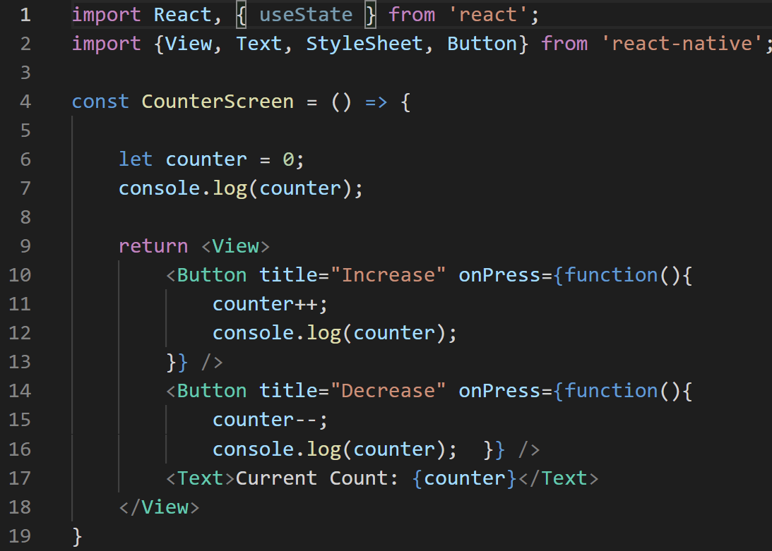

Intro to State!
So, this is us, importing useState.
Great!
Now, in order to use it, we need to change the way we are declaring our variable…
Warning: it’s going to look funky.

Slide 40
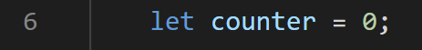
Intro to State!
We are basically going to take our own variable declaration.
That was good and clean and simple and basically syntax we are used to…
And replace it with this line:
That’s kinda wild.
Let’s break it down, but also…

Slide 41
Intro to State!
We are basically going to take our own variable declaration.
That was good and clean and simple and basically syntax we are used to…
And replace it with this line:
That’s kinda wild.
Let’s break it down!

Slide 42

Intro to State!
First, let’s look at that useState(0) part. This is the hook we imported!
The argument we are passing in, 0, is us specifying what the default value of the variable should be.

Slide 43
Intro to State!
useState() returns an array, that has two elements inside of it:
What the current value of the variable is
A function that we can use to change the value of the variable.
We are storing these elements using array destructuring.

Slide 44
Intro to State!
As a quick aside about array destructuring…
In JavaScript, you can create an array like so:
const names = [‘Jenny’, ‘Greg’];
And can access them and store them in variables in the usual way:
let name0 = names[0]; // will store Jenny
let name1 = names[1]; // will store Greg

Slide 45
Intro to State!
But what you might be less familiar with, is array destructuring!
Basically, a way to assign multiple variables values from an array on a single line.
const names = [‘Jenny’, ‘Greg’];
const [name0, name1] = names;
The first element of the names array here would get stored in name0. The second element of names would get stored in name1.
name0 and name1 are *not* an array. They are just variables. We could have given them any identifiers we wanted!
console.log(name0)// will print Jenny
console.log(name1); // will print Greg

Slide 46


Intro to State!
So again, jumping back to here…
useState(0) is going to return an array…
And the first element of it will get stored in counter.
And the second element of it will get stored in setCounter.

Slide 47
Intro to State!
And thus, counter here, represents the piece of state that is going to be changing.
But here’s the catch: if we want the screen to render again when it changes, we aren’t allowed to modify the counter variable directly.
Doing so would result in the exact same issue as before: the screen would never re-render.

Slide 48
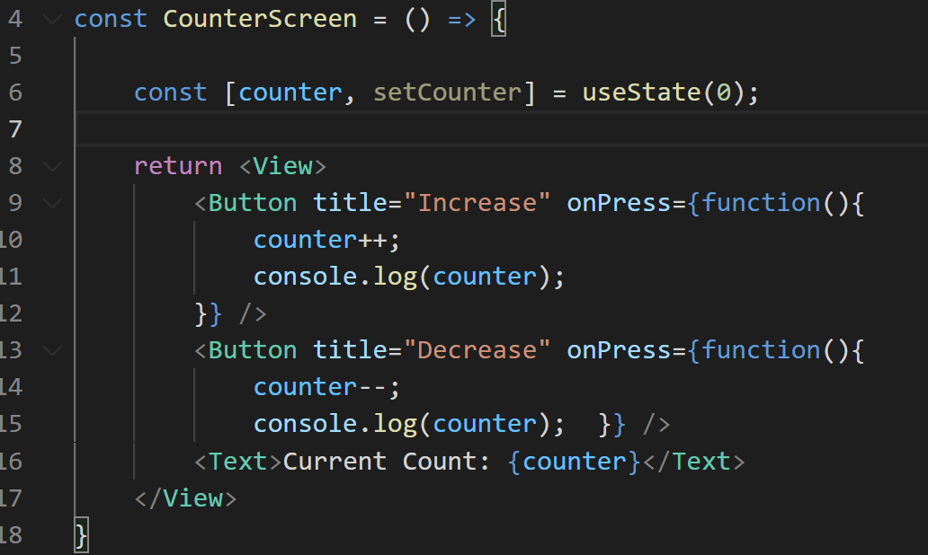


Intro to State!
So even with the updated line 6, this code is still problematic.
Because lines 10 and 14 are modifying the variable directly!

Slide 49
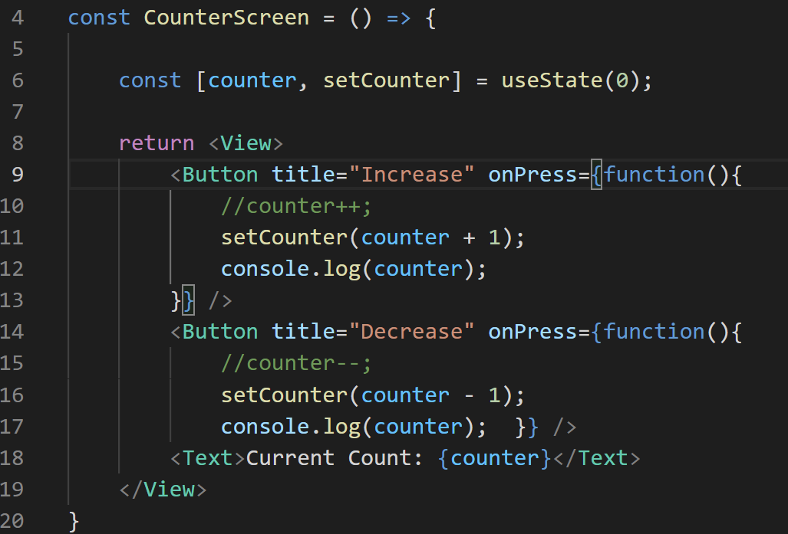


Intro to State!
Instead, you have to use the second thing that useState() returned: the thing that we called setCounter()
Note: nothing sacred about that name. We could have called it anything we wanted!
This is a function that will take in one argument: what the new value of counter should be.
When it gets invoked, the screen re-renders.

Slide 50
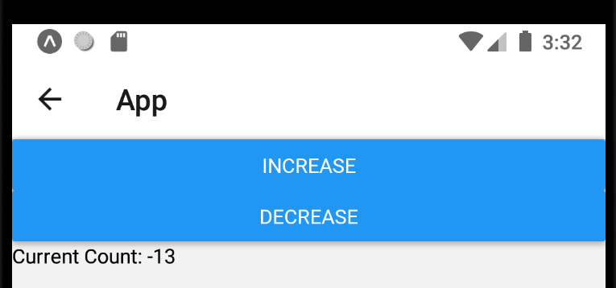
Intro to State!
And with that, we now have created a lovely little app, that re-renders when you click a button.
Phew!

Slide 51
Intro to State!
So just to be clear, whenever setCounter gets called, we basically re-run all of this code.
The difference is that the value of counter will be whatever got passed in as the argument to setCounter.

Slide 52
Intro to State!
I also just want to draw your attention to some of these questions…
1.) What piece of data is changing?
2.) What is the type of the changing data?
3.) What is the data’s starting value?
This line of code dealt with all three of them, right?
1.) – “counter” here – the name of the variable
2.) – the type of the argument that we pass in to useState
3.) – the value of the argument that we pass in to useState

Slide 53
Today’s Agenda
Intro to State
A Quick Lifecycle Diagram And Other Notes
Color App

Slide 54
Quick Lifecycle Diagram
App Starts Up
Navigate to CounterScreen
‘counter’ piece of state is initialized to 0.
User taps one of the buttons (say, “increase”), and the ‘onPress’ callback begins
Just to make sure we were all following along there, and also to elaborate on what was going on “between the cracks” there, let’s just recap step by step what just happened.
‘onPress’ calls ‘setCounter’, and updates the piece of state’s value
After a *very brief pause*, the screen rerenders, redisplaying CounterScreen
CounterScreen was already ran once! So the state variable ‘counter’ *is not* initialized again.
‘counter’ now has an updated value of ‘1’
We return some JSX that references the updated ‘counter’ variable.

Slide 55
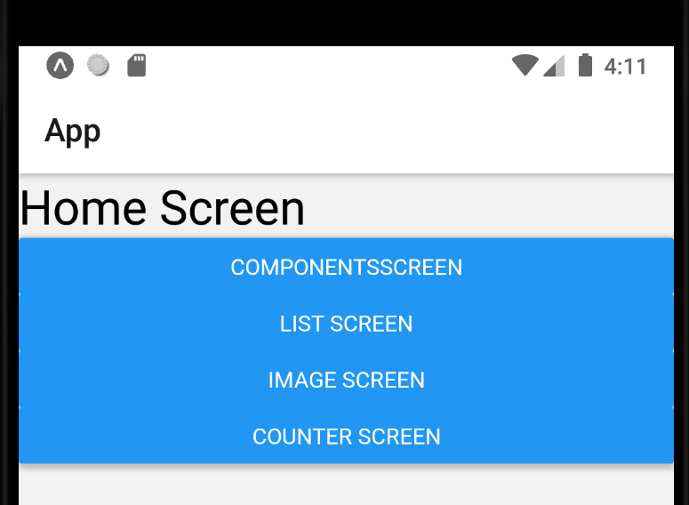
Quick Lifecycle Diagram
App Starts Up
Navigate to CounterScreen
‘counter’ piece of state is initialized to 0.
User taps one of the buttons (say, “increase”), and the ‘onPress’ callback begins
App Starts Up…
‘onPress’ calls ‘setCounter’, and updates the piece of state’s value
After a *very brief pause*, the screen rerenders, redisplaying CounterScreen
CounterScreen was already ran once! So the state variable ‘counter’ *is not* initialized again.
‘counter’ now has an updated value of ‘1’
We return some JSX that references the updated ‘counter’ variable.

Slide 56
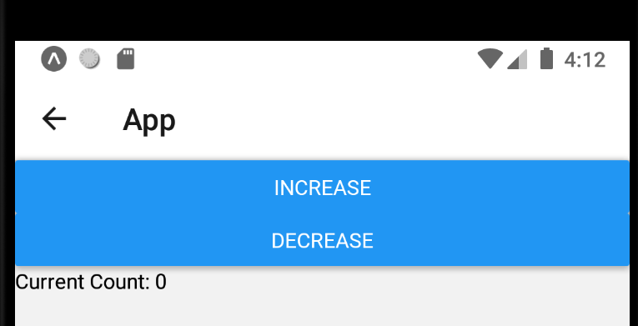
Quick Lifecycle Diagram
App Starts Up
Navigate to CounterScreen
‘counter’ piece of state is initialized to 0.
User taps one of the buttons (say, “increase”), and the ‘onPress’ callback begins
‘onPress’ calls ‘setCounter’, and updates the piece of state’s value
After a *very brief pause*, the screen rerenders, redisplaying CounterScreen
CounterScreen was already ran once! So the state variable ‘counter’ *is not* initialized again.
‘counter’ now has an updated value of ‘1’
We return some JSX that references the updated ‘counter’ variable.

Slide 57
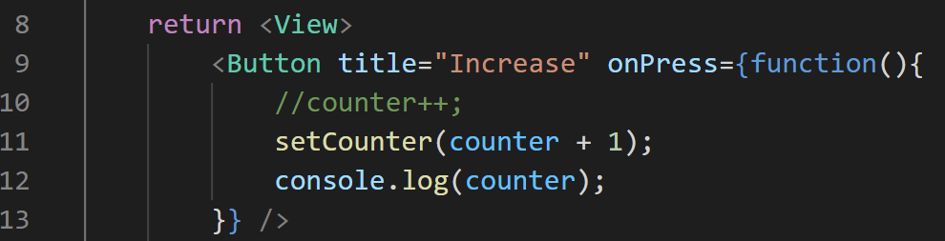

Quick Lifecycle Diagram
App Starts Up
Navigate to CounterScreen
‘counter’ piece of state is initialized to 0.
User taps one of the buttons (say, “increase”), and the ‘onPress’ callback begins
‘onPress’ calls ‘setCounter’, and updates the piece of state’s value
After a *very brief pause*, the screen rerenders, redisplaying CounterScreen
CounterScreen was already ran once! So the state variable ‘counter’ *is not* initialized again.
‘counter’ now has an updated value of ‘1’
We return some JSX that references the updated ‘counter’ variable.

Slide 58
Quick Lifecycle Diagram
App Starts Up
Navigate to CounterScreen
‘counter’ piece of state is initialized to 0.
User taps one of the buttons (say, “increase”), and the ‘onPress’ callback begins
‘onPress’ calls ‘setCounter’, and updates the piece of state’s value
After a *very brief pause*, the screen rerenders, redisplaying CounterScreen
CounterScreen was already ran once! So the state variable ‘counter’ *is not* initialized again.
‘counter’ now has an updated value of ‘1’
We return some JSX that references the updated ‘counter’ variable.

Slide 59
Quick Lifecycle Diagram
App Starts Up
Navigate to CounterScreen
‘counter’ piece of state is initialized to 0.
User taps one of the buttons (say, “increase”), and the ‘onPress’ callback begins
This brief pause is kind of interesting!
BEFORE the screen rerenders, more code in the callback function executes.
So here, for example, the value of counter that would be printed out is 0 – that line executes before the screen rerenders with the new value!
‘onPress’ calls ‘setCounter’, and updates the piece of state’s value
After a *very brief pause*, the screen rerenders, redisplaying CounterScreen
CounterScreen was already ran once! So the state variable ‘counter’ *is not* initialized again.
‘counter’ now has an updated value of ‘1’
We return some JSX that references the updated ‘counter’ variable.

Slide 60
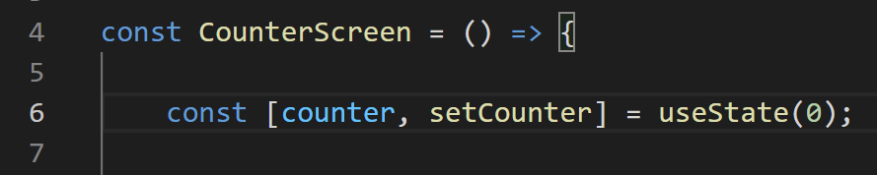
Quick Lifecycle Diagram
App Starts Up
Navigate to CounterScreen
‘counter’ piece of state is initialized to 0.
User taps one of the buttons (say, “increase”), and the ‘onPress’ callback begins
This is also a little magical.
React Native is smart enough to know that we’ve already visited this screen, and that counter has already been initialized.
So even though we still execute this line, useState() *won’t* re-initialize counter to 0.
It will use the value that was passed in to the previous call to setCounter.
‘onPress’ calls ‘setCounter’, and updates the piece of state’s value
After a *very brief pause*, the screen rerenders, redisplaying CounterScreen
CounterScreen was already ran once! So the state variable ‘counter’ *is not* initialized again.
‘counter’ now has an updated value of ‘1’
We return some JSX that references the updated ‘counter’ variable.

Slide 61
Quick Lifecycle Diagram
App Starts Up
Navigate to CounterScreen
‘counter’ piece of state is initialized to 0.
User taps one of the buttons (say, “increase”), and the ‘onPress’ callback begins
In this case, that’s going to be the value 1.
‘onPress’ calls ‘setCounter’, and updates the piece of state’s value
After a *very brief pause*, the screen rerenders, redisplaying CounterScreen
CounterScreen was already ran once! So the state variable ‘counter’ *is not* initialized again.
‘counter’ now has an updated value of ‘1’
We return some JSX that references the updated ‘counter’ variable.

Slide 62
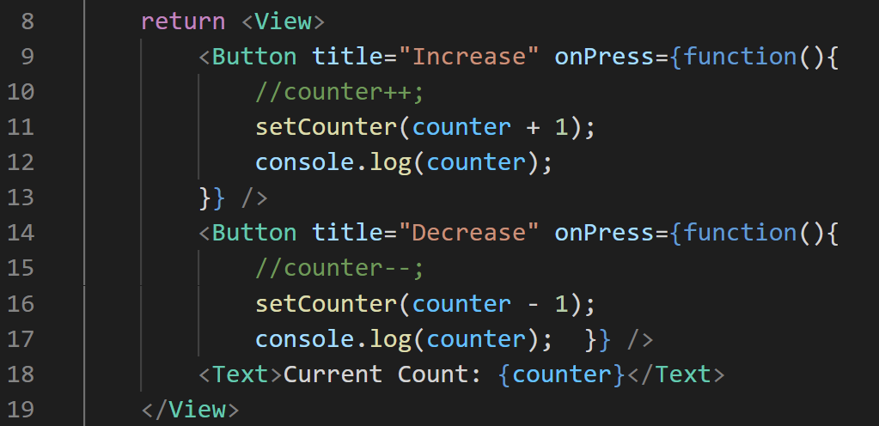
Quick Lifecycle Diagram
App Starts Up
Navigate to CounterScreen
‘counter’ piece of state is initialized to 0.
User taps one of the buttons (say, “increase”), and the ‘onPress’ callback begins
Our JSX that makes up our component is going to use this updated value.
‘onPress’ calls ‘setCounter’, and updates the piece of state’s value
After a *very brief pause*, the screen rerenders, redisplaying CounterScreen
CounterScreen was already ran once! So the state variable ‘counter’ *is not* initialized again.
‘counter’ now has an updated value of ‘1’
We return some JSX that references the updated ‘counter’ variable.

Slide 63
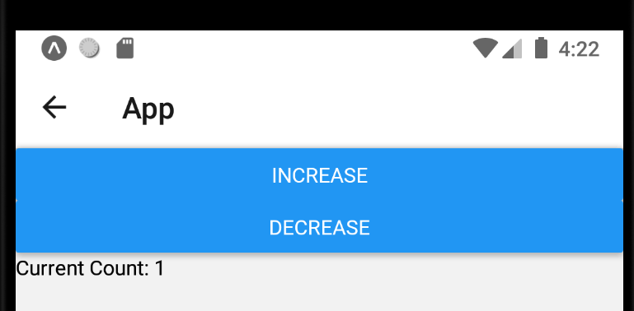
Quick Lifecycle Diagram
App Starts Up
Navigate to CounterScreen
‘counter’ piece of state is initialized to 0.
User taps one of the buttons (say, “increase”), and the ‘onPress’ callback begins
Which finally ultimately gets rendered onto the screen.
‘onPress’ calls ‘setCounter’, and updates the piece of state’s value
After a *very brief pause*, the screen rerenders, redisplaying CounterScreen
CounterScreen was already ran once! So the state variable ‘counter’ *is not* initialized again.
‘counter’ now has an updated value of ‘1’
We return some JSX that references the updated ‘counter’ variable.

Slide 64
Quick Lifecycle Diagram
There’s also a couple of quick notes that are worth saying, since if you start looking at documentation for things on your own there’s a chance you might be confused.

Slide 65
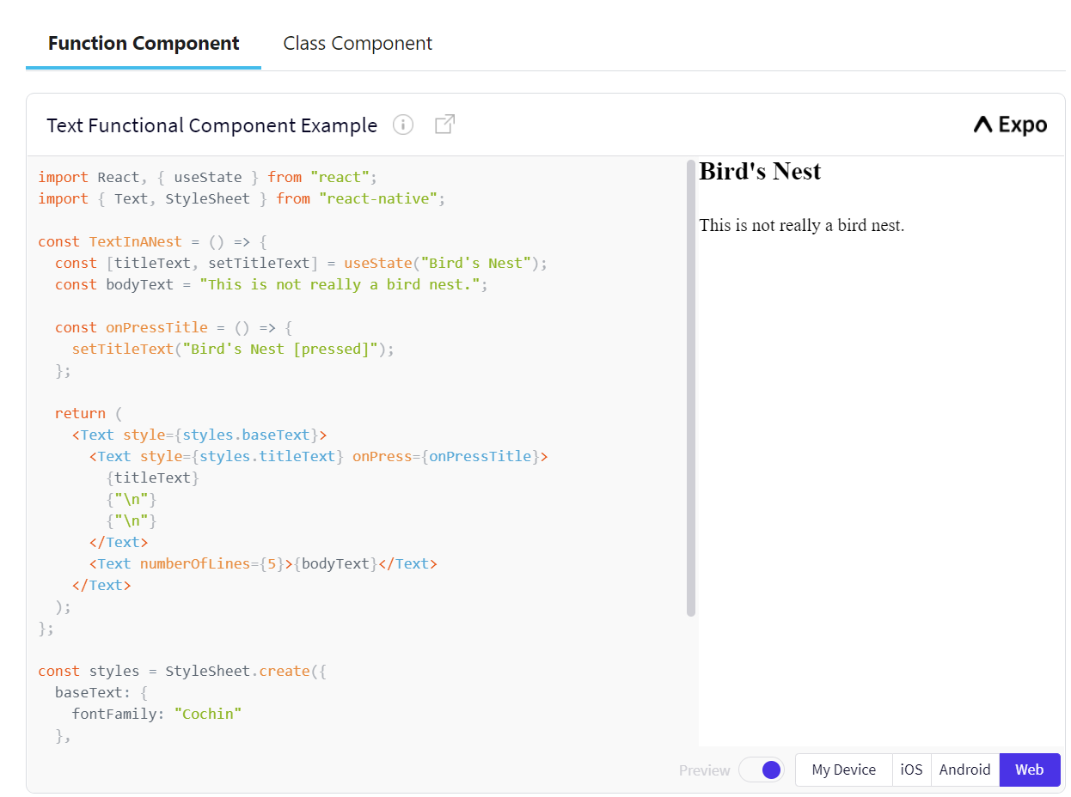
Quick Lifecycle Diagram
One is that, if you look at React Native documentation, you’ll likely see a lot of things that look like this.
The tab for “Function Component” should match our boilerplate code pretty well.

Slide 66
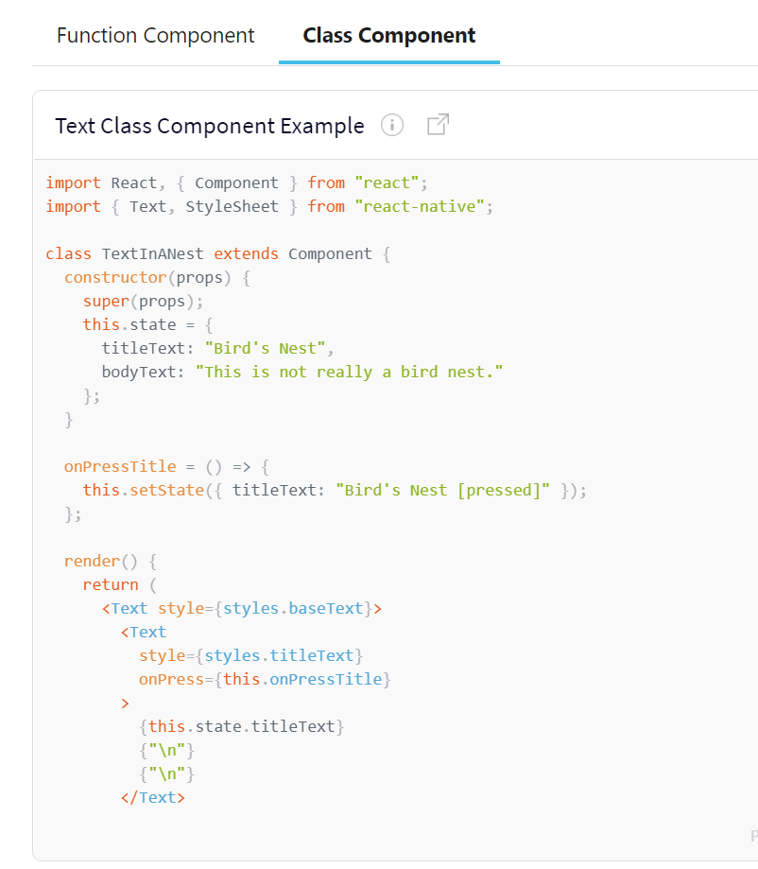
Quick Lifecycle Diagram
But then there’s also this “Class Component” tag, that is, ah, similar but different!
This is a whole ‘nother way of designing components!
At the end of the day: same ideas, just different syntax.

Slide 67
Quick Lifecycle Diagram
The React Native community seems to be veering towards functional component design, which is why we’re focusing on that.
But both options are out there!

Slide 68
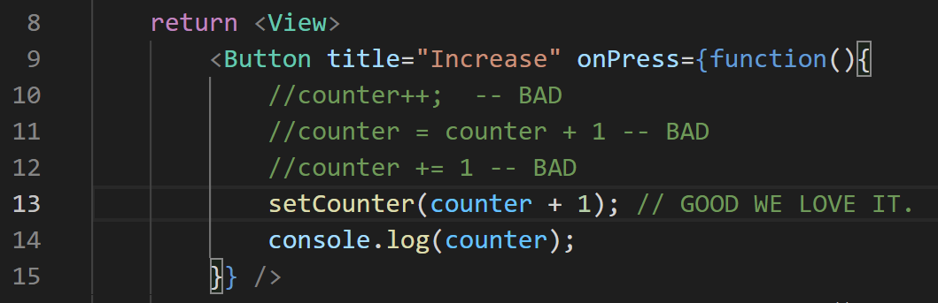
Quick Lifecycle Diagram
Another is just a re-iteration of something we’ve said already:
When using this React Native state system, you don’t update state variables directly!
We just use the setter function that the useState hook provides us!

Slide 69
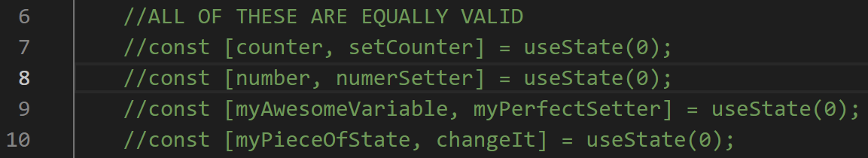
Quick Lifecycle Diagram
Yet another re-iteration of something we’ve said already:
The variable and setter function returned from useState could be called anything we wanted!
Just make sure you are consistent with the identifiers when using them throughout your code.

Slide 70
Quick Lifecycle Diagram
ImageScreen
One thing that is handy (but also potentially computationally expensive) is that when a component is rerendered, all of its children do too.
So if ImageScreen had a state variable here, every time it changes, all of the ImageDetail components would be re-rendered also.
{title: “coffee”,
image: cof.jpg”}
{title: “doughnut”,
image: d.jpg”}
{title: “sandwich”,
image: s.jpg”}
ImageDetail
ImageDetail
ImageDetail

Slide 71
Quick Lifecycle Diagram
And just a seed to plant:
state variables can be passed down to child components *as* props.
So when doing that, it kinda sorta becomes both a piece of state, and also a prop!
That’s why I mentioned that the difference between props and state can get confusing!

Slide 72
Quick Lifecycle Diagram
ImageScreen
The final note for now: if you declare a state variable inside of a component, EACH SEPARATE COMPONENT has it’s own value for that piece of state.
Let’s say that we said ImageDetail had a counter variable…
That value could be different for each different ImageDetail.
{title: “coffee”,
image: cof.jpg”}
{title: “doughnut”,
image: d.jpg”}
{title: “sandwich”,
image: s.jpg”}
ImageDetail
ImageDetail
ImageDetail
count: 3
count: -1
count: 27

Slide 73
Today’s Agenda
Intro to State
A Quick Lifecycle Diagram And Other Notes
Color App

Slide 74
Color App
Add Color
I was chatting with one of you recently about colors!
Let’s make an app that highlights some of what we’ve talked about (and shows new things!) that highlights colors!
It will be an app that has a single button.

Slide 75
Color App
Add Color
When you push the button, a square in a random color will appear.

Slide 76
Color App
Add Color
As you push it more, you get more colors

Slide 77
Color App
Add Color
In React Native, as in many other places, we can specify colors using RGB values.
i.e., how much red, how much green, and how much blue goes into the color.
By combining them in different amounts, we can create any color we can imagine!
There are also some ‘named’ colors that we’ve used in lecture, but that’s not what we’re doing here.
More on colors at https://reactnative.dev/docs/colors
rgb(0,0,0)
rgb(0,0,0)
rgb(0,0,0)
rgb(0,0,0)

Slide 78
Color App
Add Color
Once more with feeling!
1.) What piece of data is changing in this app?
Colors!
2.) What is the type of the changing data?
An array of strings (storing the rgb values).
3.) What is the data’s starting value?
It will likely begin as an empty array . (e.g., [] )
rgb(0,0,0)
rgb(0,0,0)
rgb(0,0,0)
rgb(0,0,0)

Slide 79
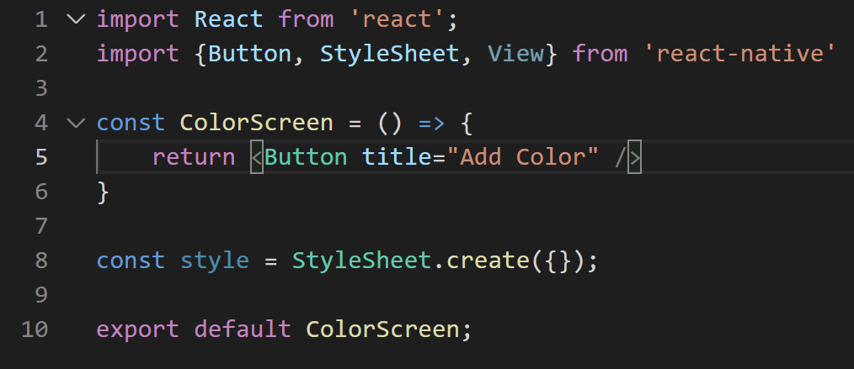
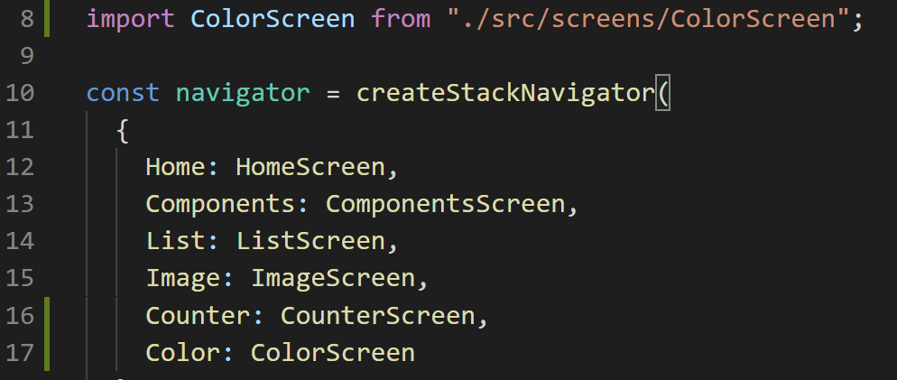
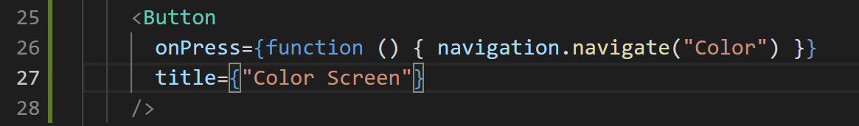
Color App
ColorScreen.js
OK, great, let’s make yet another new screen for this beautiful new app!
App.js
HomeScreen.js

Slide 80
Color App
Lovely!
Before we start fiddling around with state on this app, let’s just chat a little bit about how color works.
ColorScreen.js

Slide 81
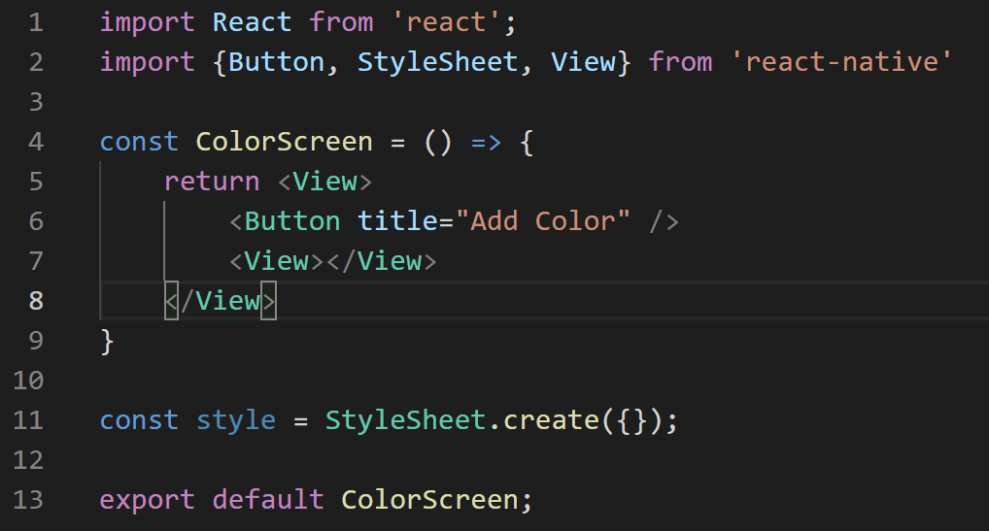
Color App
We know that we’re going to want to create squares of color.
It just so happens that a View element could be really handy for that!
Let’s add a couple Views to our app.
ColorScreen.js

Slide 82


Color App
Here we have two Views.
The first is the element that we are returning. It is serving as a container (as we’ve seen before).
It is holding a Button and another View.
That second View is currently empty.
ColorScreen.js

Slide 83
Color App
And View’s have a style property called backgroundColor (spelled *exactly* like that) that specify, well, what their background is.
We’re going to just quickly do some inline styling to quickly show this off.
ColorScreen.js

Slide 84
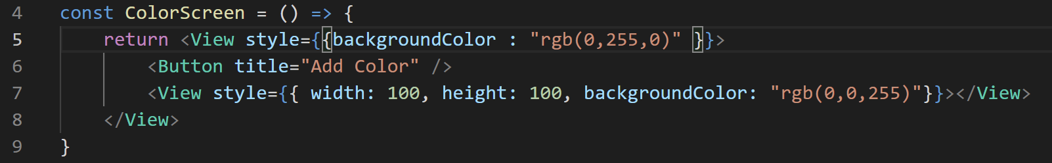
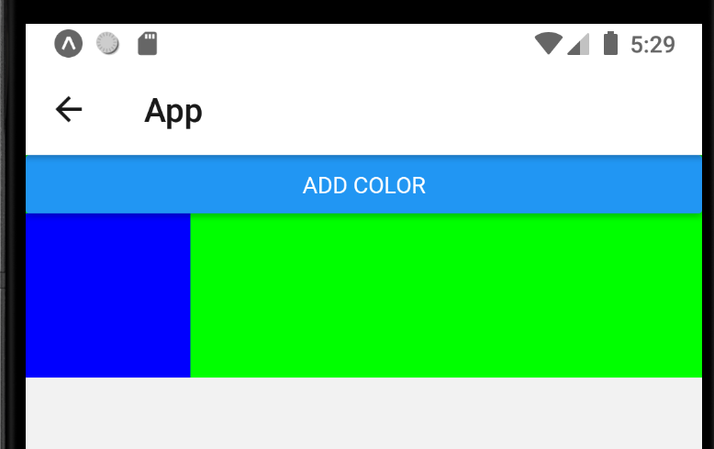

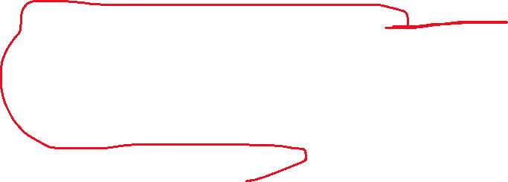
Color App
ColorScreen.js
Here, the values of rgb range from 0 (none of that color) to 255 (as much of that color as possible).
so this first view has no red, lots of green, and no blue.
The second view has no red, no green, but lots of blue.

Slide 85

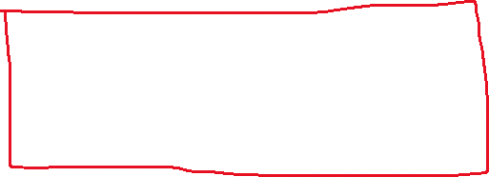

Color App
ColorScreen.js
The red line I drew represents the dimensions of the ‘outer view’ – it is just as big as it needs to be to fit its content (and no bigger!)
The Orange line represents the inner view.
We specified that it should be exactly 100 x 100, hence why it has those dimensions.

Slide 86
Color App
ColorScreen.js
So, this is a fine starting point but these squares have their colors hard coded.
We want to be able to generate new colors!
Let’s write a little helper function to let us do that!

Slide 87
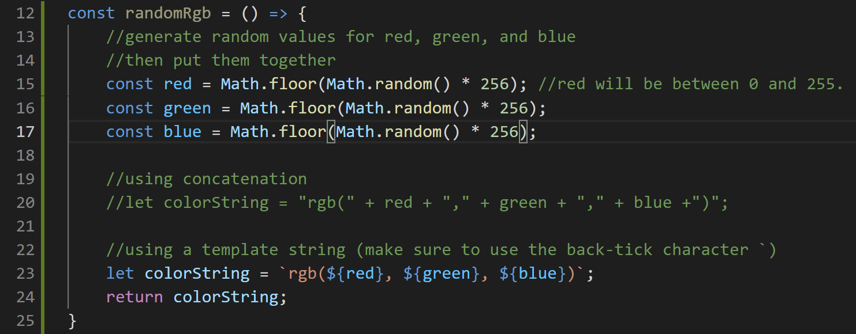
Color App
Here is a new function inside of ColorScreen.js
It’s doing a few things!
ColorScreen.js

Slide 88


Its overall goal is to generate three random values:
One value for the amount of red,
Another for the amount of green,
A third for the amount of blue.
And then combine those in the form of the string that we need to specify a color.
ColorScreen.js

Slide 89
Color App
To generate the numbers…
First, it uses Math.random() to generate a number between 0 and 1.
ColorScreen.js

Slide 90
Color App
To generate the numbers…
First, it uses Math.random() to generate a number between 0 and 1.
And then it multiples that number by 256 to turn that number to a random one between 0 and 255
Technically there’s a very small chance it might be exactly 256, but let’s just not worry about it.
ColorScreen.js

Slide 91
Color App
To generate the numbers…
First, it uses Math.random() to generate a number between 0 and 1.
And then it multiples that number by 256 to turn that number to a random one between 0 and 255
Technically there’s a very small chance it might be exactly 256, but let’s just not worry about it.
And then we wrap all of that in a call to Math.floor, which truncates the decimal
i.e., it will ensure we get a whole number.
ColorScreen.js

Slide 92

Color App
For the “string creation” part, there’s two ways presented here.
One (currently commented out) is the “normal” way you are probably used to, using string concatenation.
ColorScreen.js

Slide 93

Color App
JavaScript has an alternative way for doing things like this, using what is known as string templating.
ColorScreen.js

Slide 94

Color App
String templating is a string that is enclosed with the backtick character: `
That’s the one that shares a keyboard key with the ~ character, right below the escape key on your keyboard!)
And it makes it easy to specify variables inside of it.
Any time you need to use a variable, you wrap it around a ${ and a }
ColorScreen.js

Slide 95
Color App
However you choose to make your string, we then return it!
ColorScreen.js

Slide 96
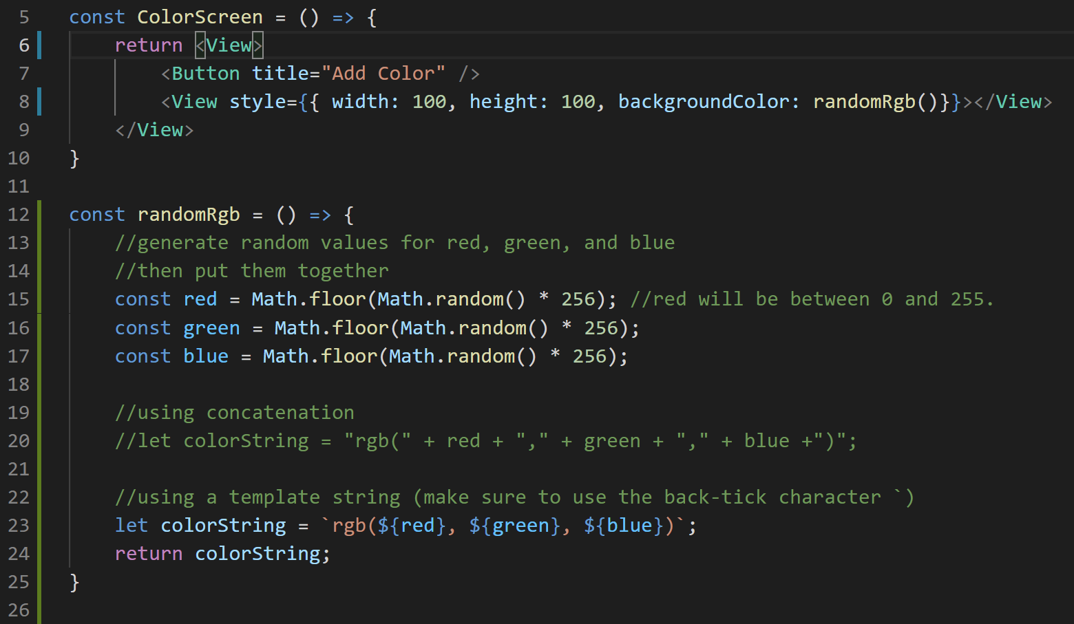
Color App
ColorScreen.js
Now that we have this nice function, let’s use it!
Specifically, we’ll call it when we are specifying the style for the inner view.
Note: I removed the style from the outer view.

Slide 97
Color App
ColorScreen.js
Now that we have this nice function, let’s use it!
Specifically, we’ll call it when we are specifying the style for the inner view.
Note: I removed the style from the outer view.

Slide 98
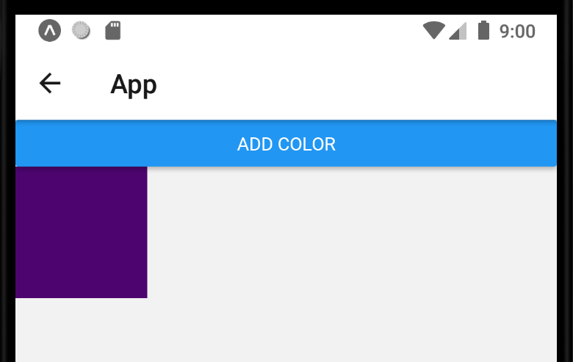
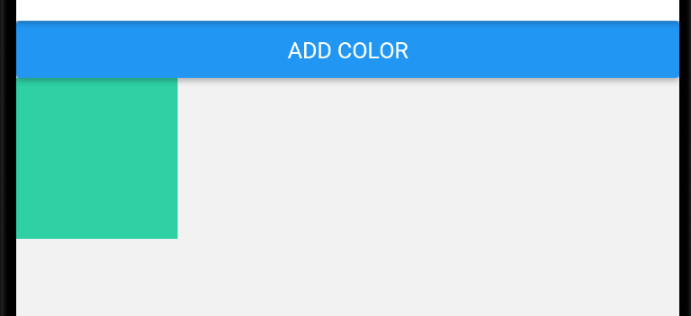
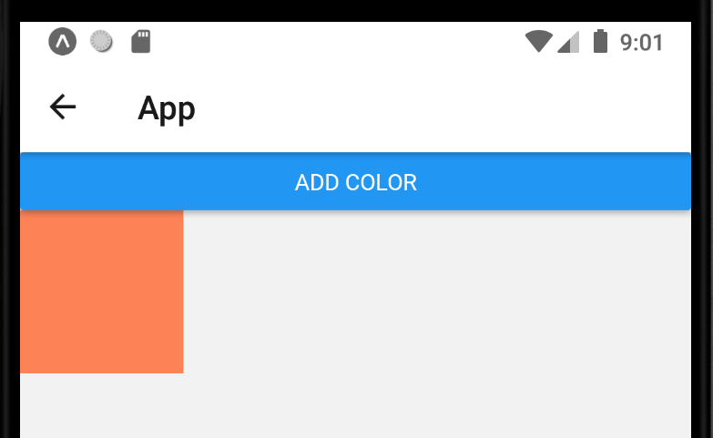
Color App
And now we’ve got a lovely little app that generates random colors!
You can “refresh” your app (and in so doing, generate a new random color), by saving your code with ctrl-s
Just as you have been to have your changes immediately reflected on your app!

Slide 99
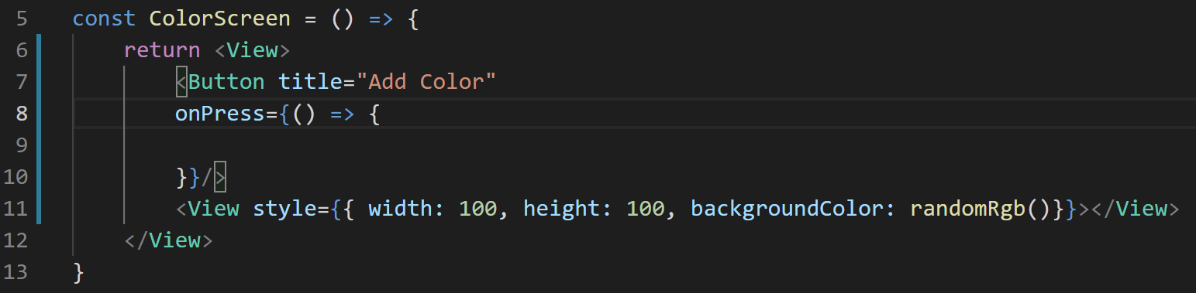
Color App
Now, let’s tackle getting that button to actually do something!
We know it’s going to need the onPress prop, so we can add that now, albeit it is currently empty!

Slide 100
Color App
And has been the name of today’s game…
We’re going to want to be able to treat these colors as a piece of state!
Remember: we agreed that treating these colors as an array of strings is probably a good way to go about doing this.

Slide 101
Color App
First, make sure to import the useState hook from the react library!

Slide 102

Color App
Then, we’ll add that array destructuring line in our function component!

Slide 103
Color App
Then, we’ll add that array destructuring line in our function component!
Recall that useState takes in the default value of our state variable
And since we want colors to be an array, the default value is just going to be the empty array here.

Slide 104
Color App
Then, we’ll add that array destructuring line in our function component!
Recall that useState takes in the default value of our state variable
And since we want colors to be an array, the default value is just going to be the empty array here.
Also recall: we’ll never want to change the colors array directly. If we ever want to add something to it, we’ll need to use this setColors function.

Slide 105

Color App
Because we can’t modify the colors array directly, we *can’t* do something like this!
Note the body of the onPress callback now!
We’re just adding something directly to colors! Not allowed here!

Slide 106

Color App
Instead, as previously stated, we need to make use of the setColors() function.
Maybe something like the above!

Slide 107
Color App
Instead, as previously stated, we need to make use of the setColors() function.
Maybe something like the above!
The outer [ and ] is creating an entirely brand new array to pass in to the function

Slide 108
Color App
Instead, as previously stated, we need to make use of the setColors() function.
Maybe something like the above!
The outer [ and ] is creating an entirely brand new array to pass in to the function
The …colors is saying “hey, the first elements of this new array should be the entirety of the existing colors array!”

Slide 109
Color App
Instead, as previously stated, we need to make use of the setColors() function.
Maybe something like the above!
The outer [ and ] is creating an entirely brand new array to pass in to the function
The …colors is saying “hey, the first elements of this new array should be the entirety of the existing colors array!”
And our call to randomRgb() is saying “and then, add another new element to this array: whatever gets returned from the function randomRgb()”

Slide 110

Color App
If you add in a console.log line to see the contents of colors…

Slide 111

Color App
You should see that the array gets bigger and bigger, adding a new random color each time!

Slide 112
Color App
We’ll revisit this as we talk more about state next time!
But in the meantime: another challenge:
Now that you have this lovely array of colors…
See if you can display all of the colors as different views as a FlatList on your own!
Good luck!

